Slide 1
MoreApp
Press kit

Slide 2
How it works
MoreApp provides you non-branded, generic visuals of the product that shows the application.
These may be used on your website or other channels of choice.
ℹ Please refrain from adding your own branding to the visuals.
ℹ Do not reshape or distort the visuals.
ℹ Download the visuals in various translations.
ℹ Find all visuals to download in this folder

Slide 3
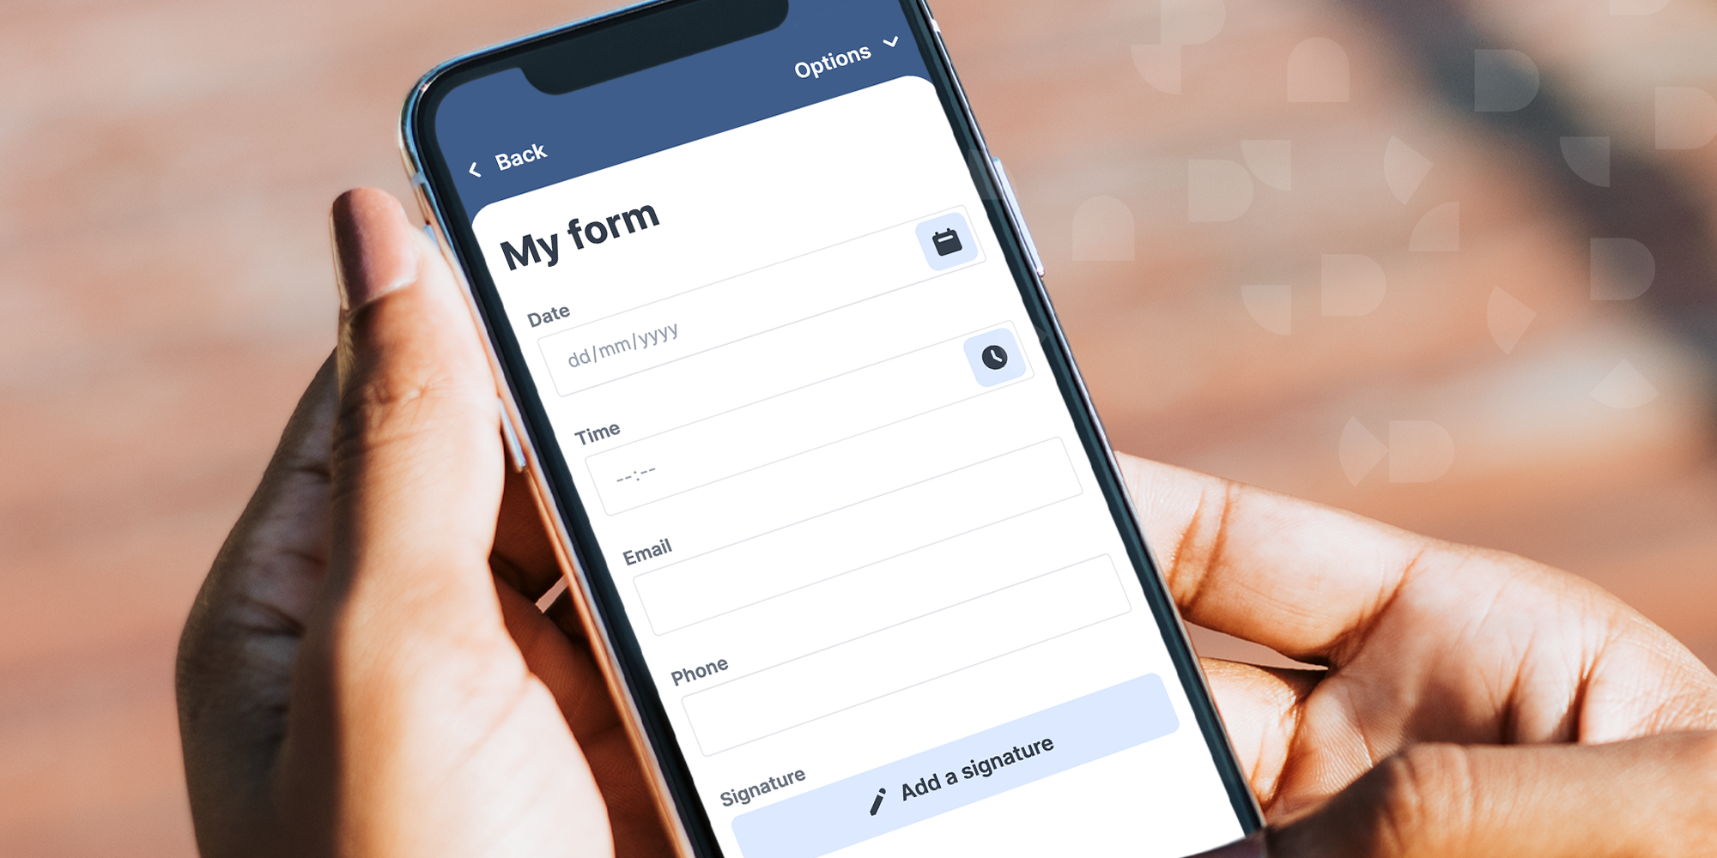
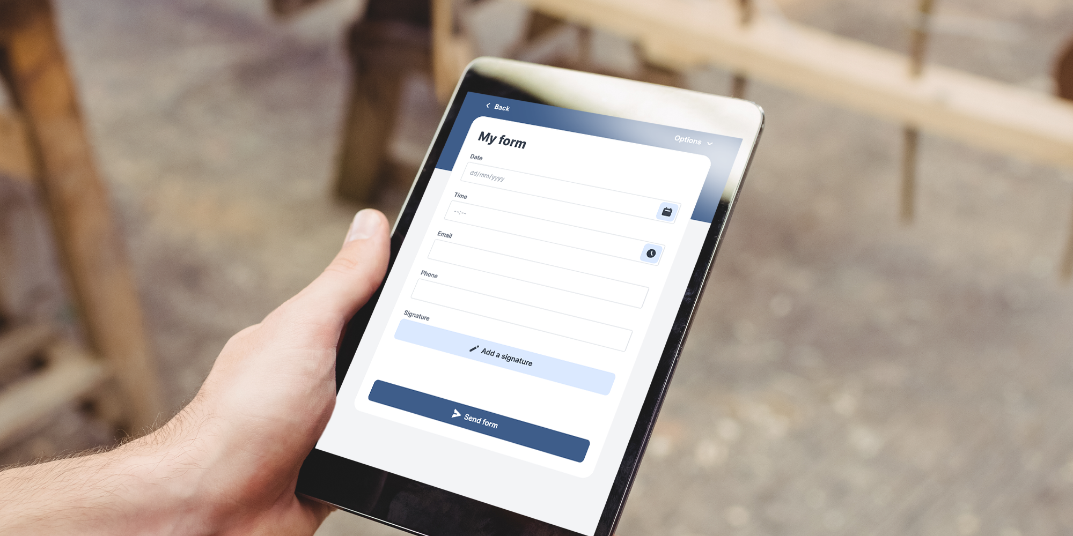
Landscape shaped
Visuals
Download a visual from this folder
Size: 1000x2000 pixels
ℹOptional: Cut sides to desired size.

Slide 4
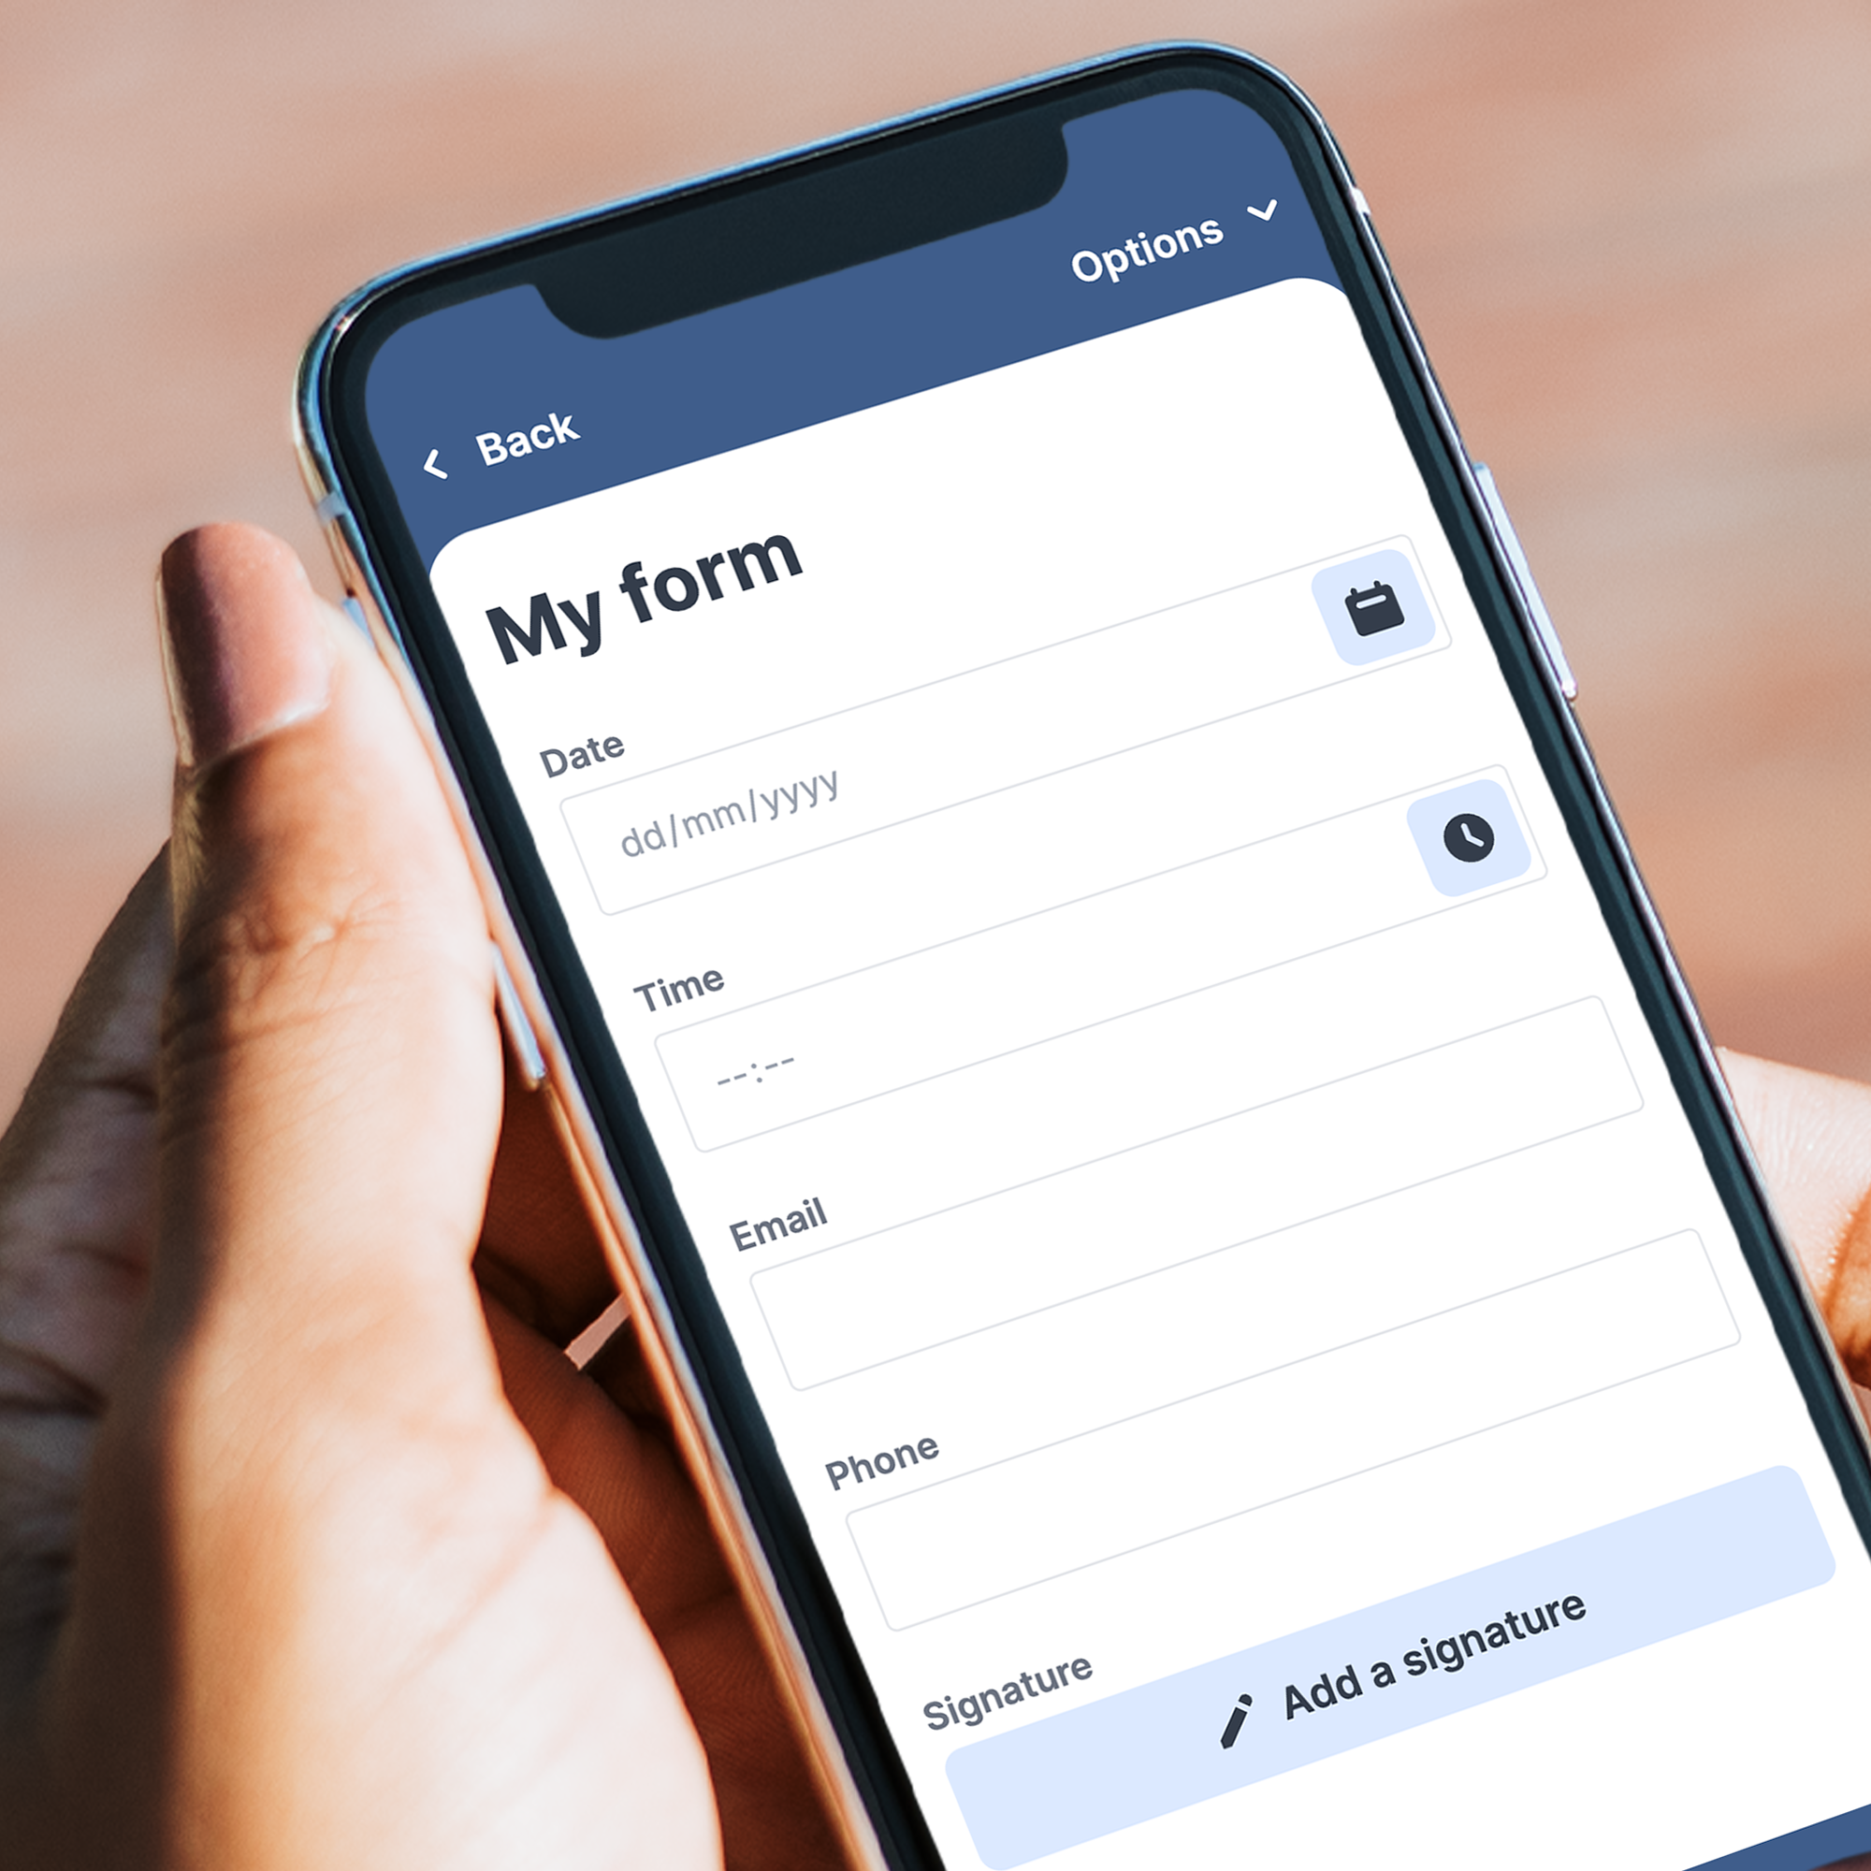
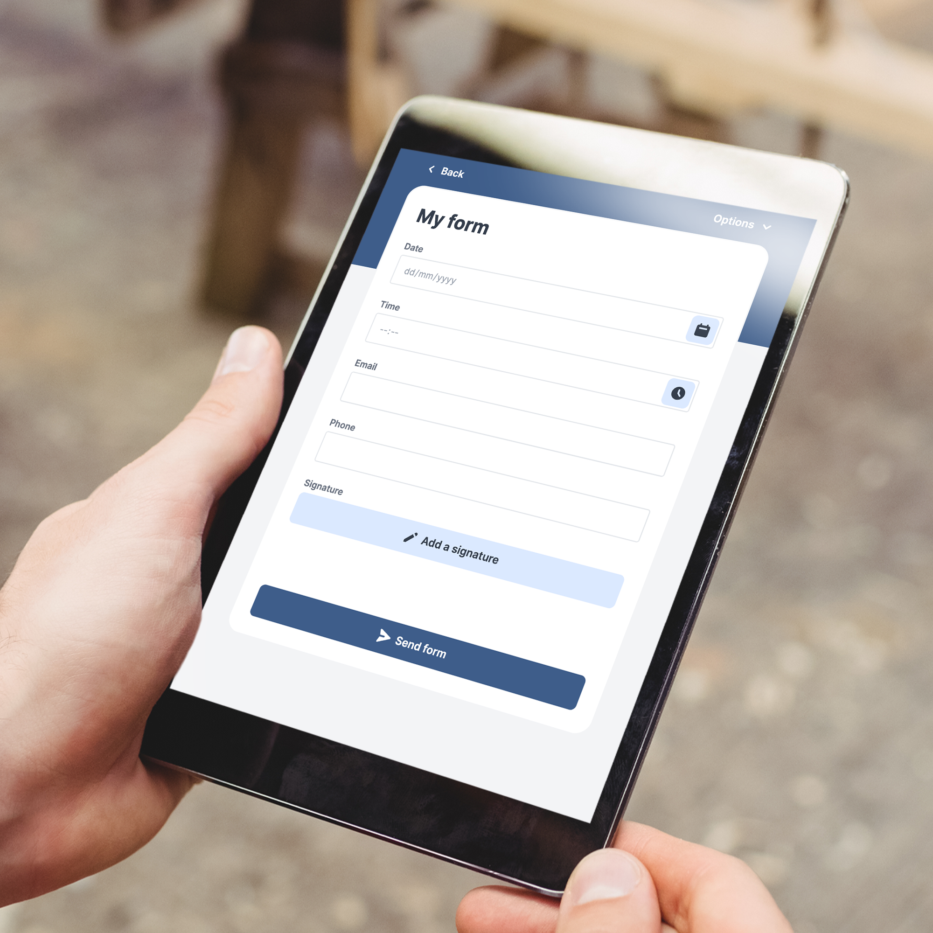
Square shaped
Visuals
Download a visual from this folder
Size: 2000x2000 pixels

Slide 5
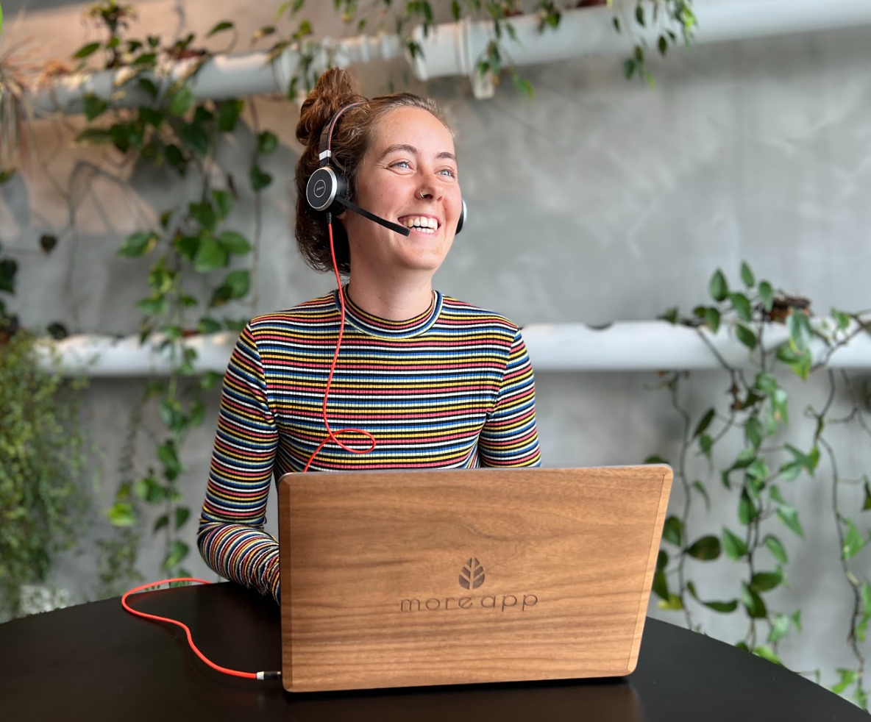
Contact
If you have any questions about the use of this MoreApp press kit, please contact us via email at design@moreapp.com.
We are happy to help you!

